Slide 1


THE POTENTIAL OF THE ORC TECHNOLOGY FOR WASTE HEAT RECOVERY IN THE EU
Sylvain Quoilin & Vincent Lemort
University of Liège, Belgium

Slide 2
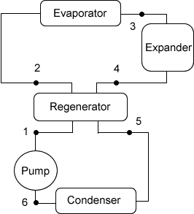
Introduction
What is an ORC cycle?
Waste heat recovery or renewable energies: solar, biomass, geothermal
Organic compound vs water
=> Valorize low t° heat sources
Electricity/mechanical power
Heat (heating demand)

Slide 3
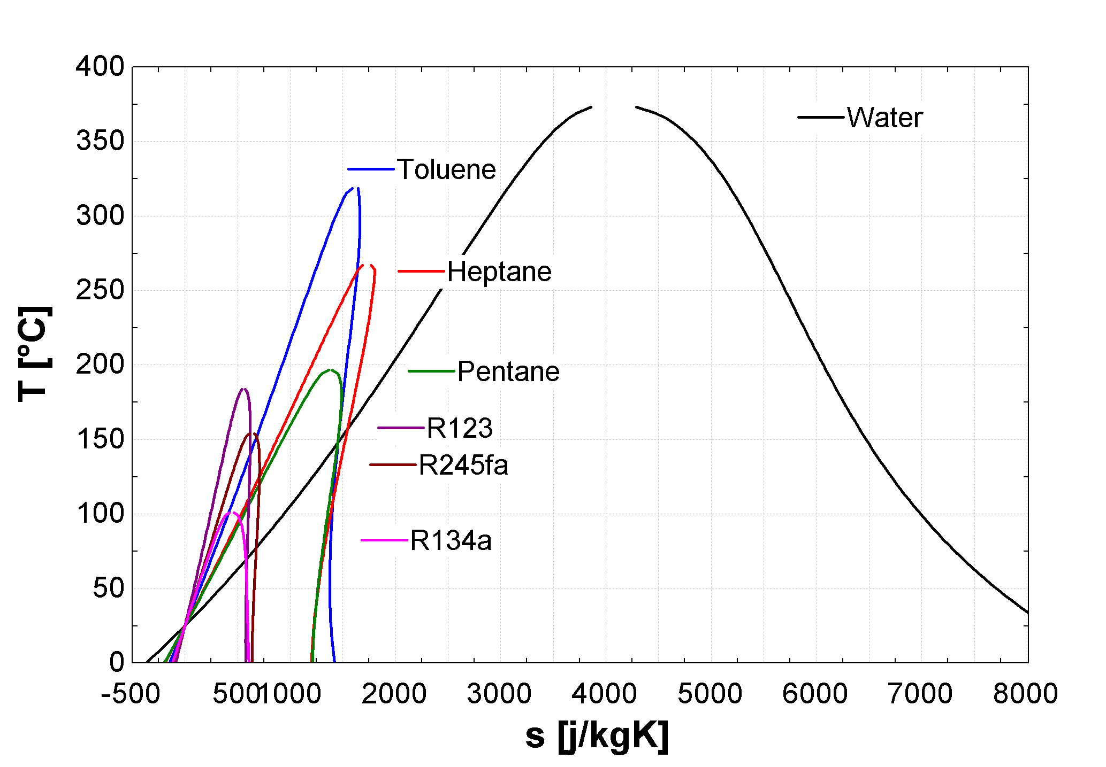
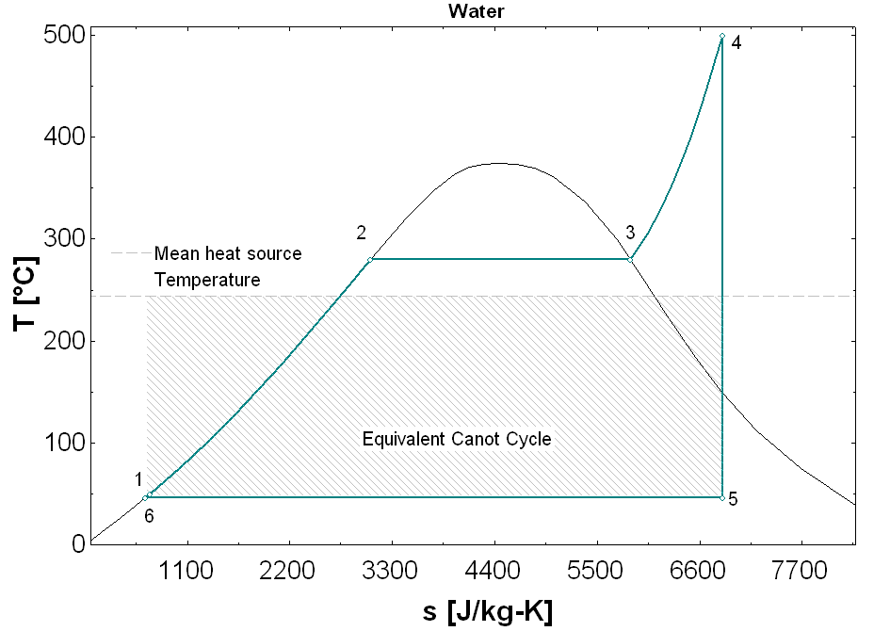
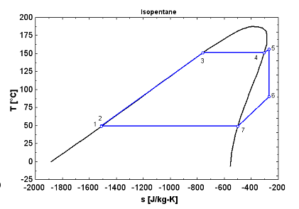
Introduction
Organic Fluids
Dry fluids => no threat of damage for the turbine
High vapor density
Working fluid at low pressure(<30 bar)
Pressure in the condenser possibly higher than ambient pressure (no infiltration)
Notes:
Here are a few typical working fluids.
All the problem is to select the right working fluid

Slide 4
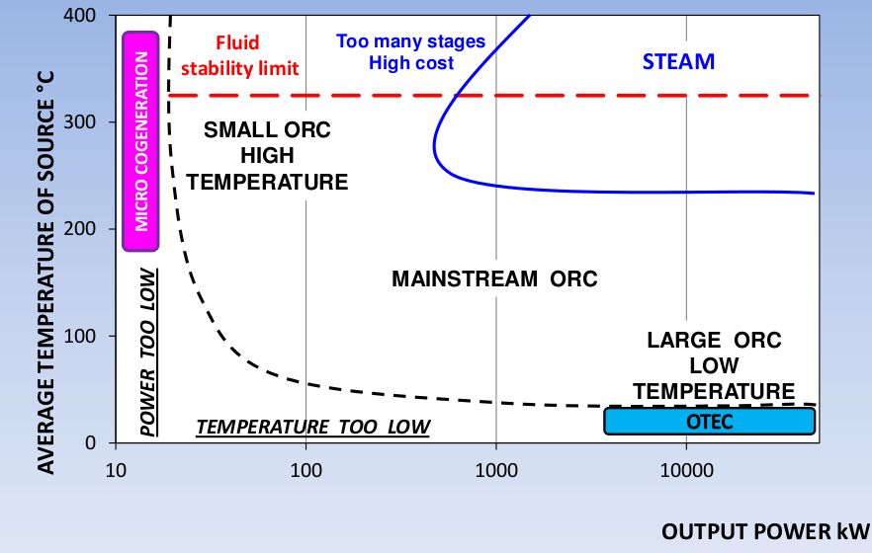
Introduction
ORC versus Steam cycles
Simpler architecture
Easy to install (in a pre-assembled squid), compact and reliable
Autonomous system
ORC systems: more economically profitable than steam cycles for powers lower than ~1MWe (steam cycles necessitate high P & T)
Heat source t° between 100°C and 350°C
Source: Gaia, 2011

Slide 5
Applications

Slide 6
Biomass CHP
Working fluid: usually siloxanes (OMTS)
Condensing around 90°C
Cheaper and less complex boiler, since
  Heats a thermal oil at low temperature up to 350°C
  Steam cycle: high pressure (60-70 bar) and necessary to superheat (450°C)
Electrical efficiency : η~18%
Concurrent technologies: gasification, steam

Slide 7
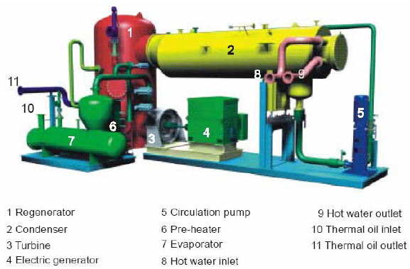
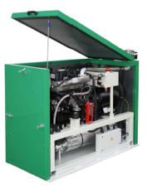
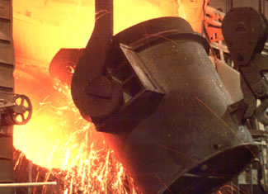
Waste heat recovery
Tremendous quantities of waste heat in industrial processes
  Cement industry
  Paper industry
  Air compression
  Glass industry
  …
ICEs are still wasting about 2/3 of the fuel energy
  Vehicles
  Biogas turbines
  …
Notes:
cimenterie:
8% de la consommation énergétique industrielle mondiale (et en croissance)
40% de la chaleur est produite sous forme de gaz entre 215 et 315°C
Potentiel de 15MWe en France (Société française de chimie, 2005)
Récupération des gaz <120°C (avec η=10%) sur 10% cimenteries européennes: 470 GWhe p.a. (Projet FP7 LOVE, 2010)

Slide 8
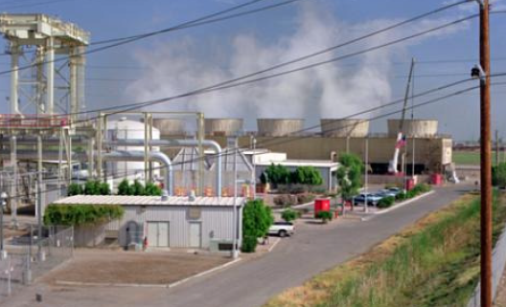
Geothermal power
Similar to WHR technologies
From 200 kW up to 100 MW
75 to 300°C

Slide 9
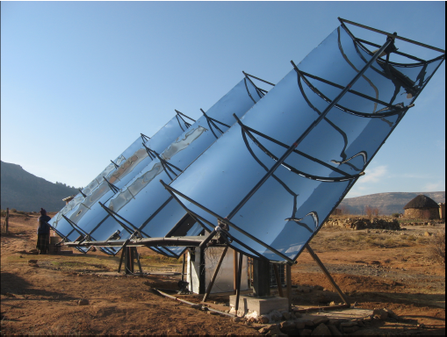
Solar power
Only one 1MWe commercial plant in Arizona
Prototypes being developed for remote power generation:
  Several ORC field trials installed in Lesotho
  Aim : Replacing Diesel generators, at a lower cost
  Low temperature (<200°C) for cost savings
  Use of HVAC and car components : air-conditioning scroll compressor, steering pump
  Self-designed autonomous control unit

Slide 10
Cycle components

Slide 11

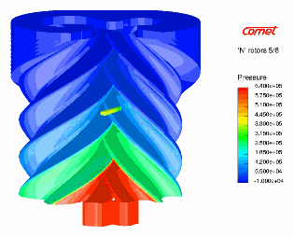
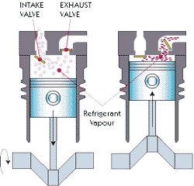
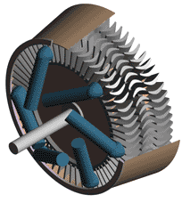
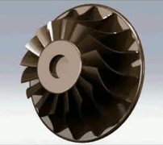
Cycle components:
Expansion Machine
Volumetric expanders
Turbomachines
Scroll
Screw
Piston
Axial
Radial
1 kWe – ~200 kWe
Min ~50 kWe

Slide 12
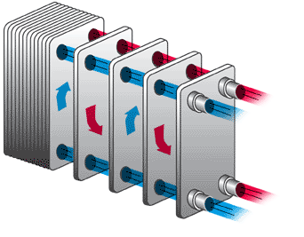
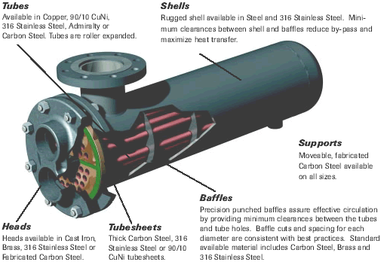
Cycle components:
Heat exchangers
Technology and sizing result of economic considerations:
  Pinch point value (efficiency)
  Pressure drops
Integrated solutions

Slide 13
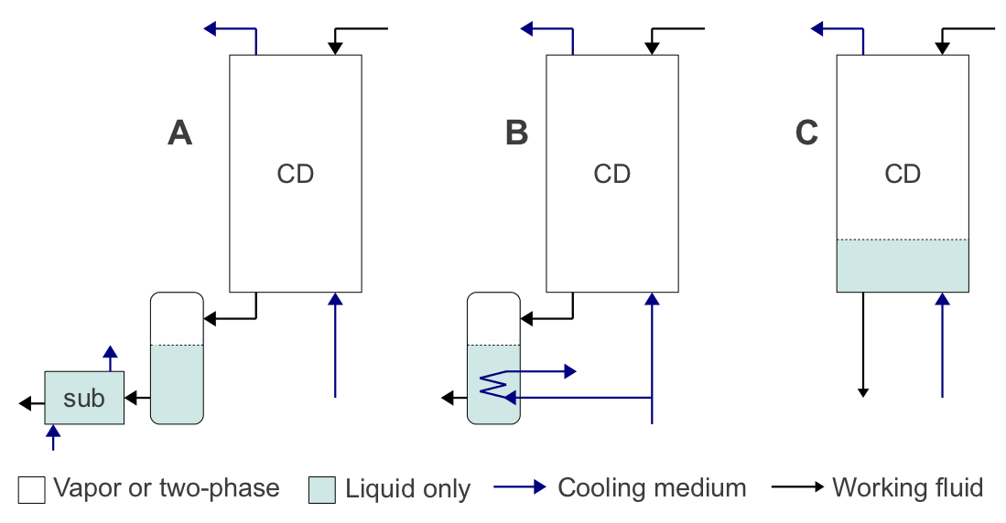
Cycle components:
Feed pump
Low efficiencies at small-scale: prejudicial at low temperature!
NPSH & cavitation issues

Slide 14
Market Evolution

Slide 15
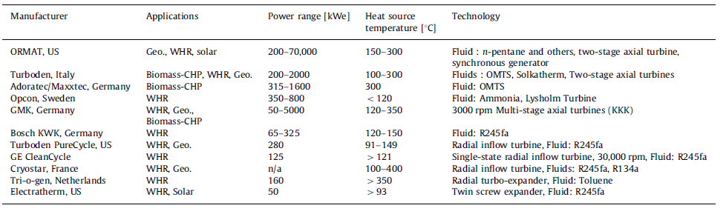
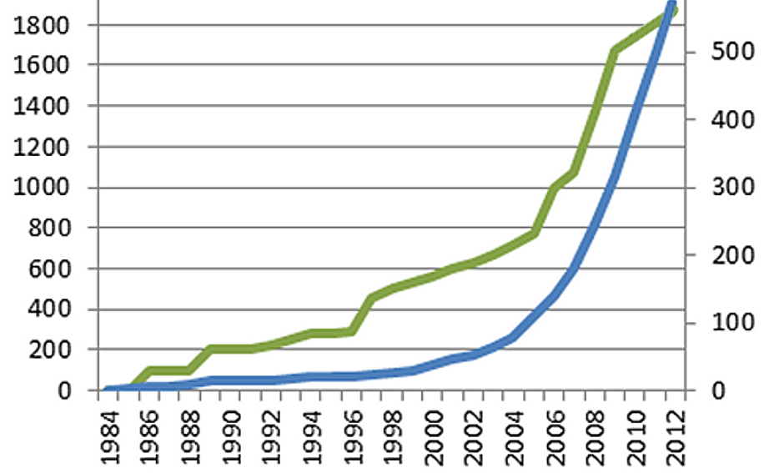
Market evolution
Growing market
3 important markets:
  Waste heat recovery (WHR): 20%
  Biomass combined heat & power (CHP): 48%
  Geothermal energy: 31%
Still few solar applications
Technological maturity >50 kWe
Powers <50 kWe: mainly in R&D

Slide 16
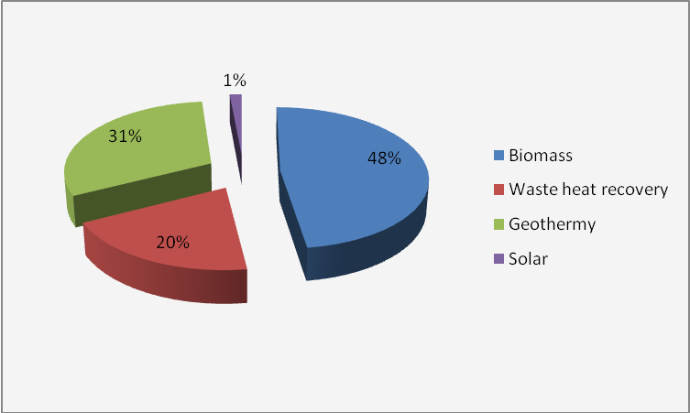
Market share & prices

Slide 17
Potential assessment for Waste Heat Recovery

Slide 18
WHR potential assessment:
Main industries
Requirements:
  Minimum temperature
  Minimum thermal power
  Minimum running hours
  No condensation
  Possibility to interfere in the process
H-REII project: establish which industries fit better ORC opportunities for heat recovery to power:
  Cement
  Glass
  Steel
  Oil&gas

Slide 19
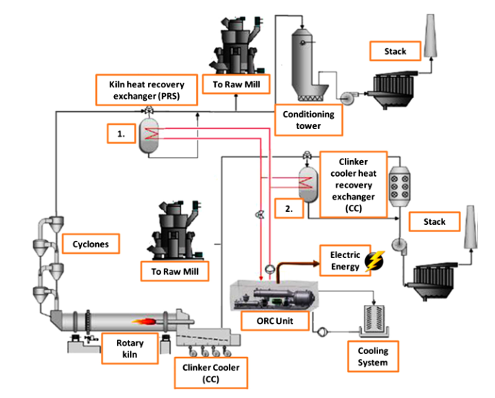
Cement
259 cement plants in EU27
389 kilns
pre-hating cyclones
clinker cooler gases
Source: Campana et al., ORC waste heat recovery in European energy intensive industries: Energy and GHG savings
Notes:
Depending on the plant can be one source or both
In 2012, cement production in EU27: 150 MT
Rp = 1.01 kw.day/T => 25 kWh/T

Slide 20
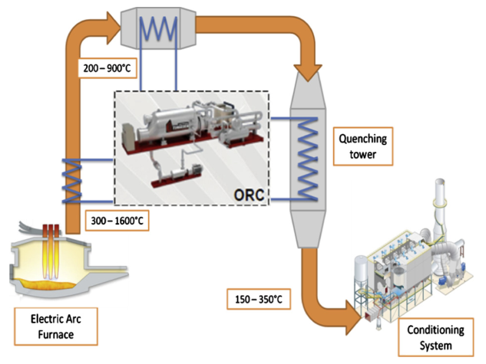
Steel:
Electric arc furnace
Many processes and techniques in steel industry
EAF is promising
3 possible locations:
  0utside the furnace (300–1600 °C),
  before the quenching tower (200–900 °C)
  Fluid used in the quenching tower
Source: Campana et al., ORC waste heat recovery in European energy intensive industries: Energy and GHG savings
Notes:
Three different layouts can be conceived: heat exchangers can be placed just outside the furnace (300–1600 ?C), before the quenching tower (200–900 ?C) or recovering heat from the fluid
used in the quenching tower. Inlet gases into conditioning system have temperature values of 150–350 ?C [46]. Unlike cement or glass process, EAFs work in cycle of almost one hour each (tap-
to-tap-time), thus ORC has an automatic control that follows the melting cycle.
quenching is the rapid cooling of a workpiece to obtain certain material properties
Modern furnace types include electric arc furnaces (EAF), induction furnaces, cupolas, reverberatory, and crucible furnaces
In 2012: 144 MT of raw steel produced in EU27

Slide 21
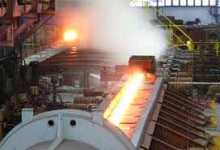
Steel:
Rolling mills
Cold/hot
Different type of mills
Audit only performed for a few types
Notes:
Hot rolling mills work with steel at temperature around
1500 °C and heat transfer is performed by direct exchange between
the organic working fluid and the heat source at temperature
around 400 °C simplifying the system layout

Slide 22
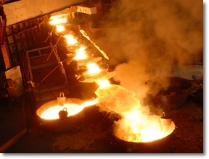
Glass industry
Very different types
Focus on flat plate glass industry
No data for container glass
Source: Campana et al., ORC waste heat recovery in European energy intensive industries: Energy and GHG savings
Notes:
Heat from the glass furnace
Also from glass cooling down

Slide 23
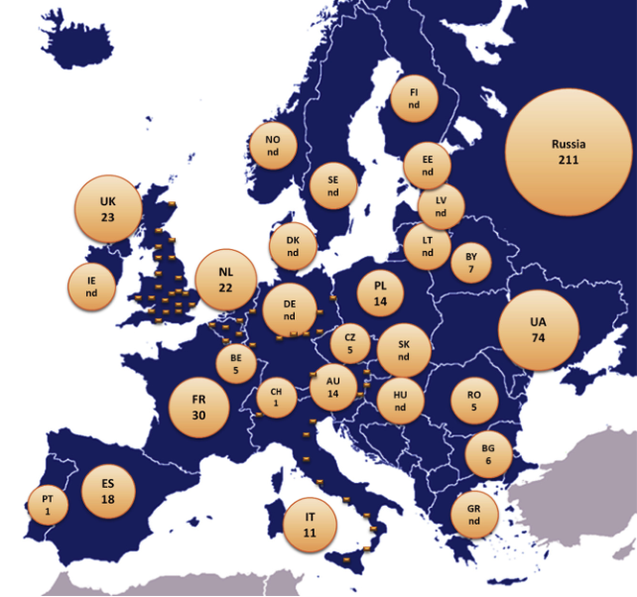
Oil & Gas:
Natural Gas Recompression
Gas turbines every 100-200 km to drive the compressor
Backup and baseload units
Exhaust gases at high temperature
Up to 35% recovery
Source: Campana et al., ORC waste heat recovery in European energy intensive industries: Energy and GHG savings
Notes:
Baseload: 8000h/y
Or if seasonal variations: 4000

Slide 24
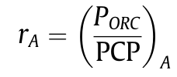
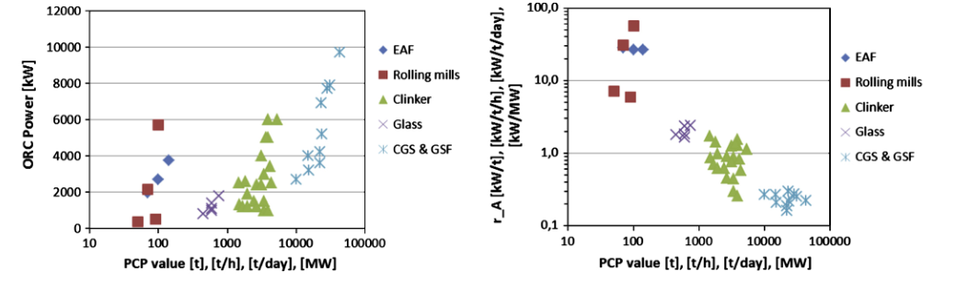
Potential calculation
Definition of Process Capacity Parameter (PCP)
Definition of the specific power ratio:
Extrapolation
Source: Campana et al., ORC waste heat recovery in European energy intensive industries: Energy and GHG savings
Notes:
Electric Arc Furnaces (EAF)
Gas Compressor Stations (GCS)
Gas Storage Fields (GSF)
Process Capacity Parameter (PCP)

Slide 25
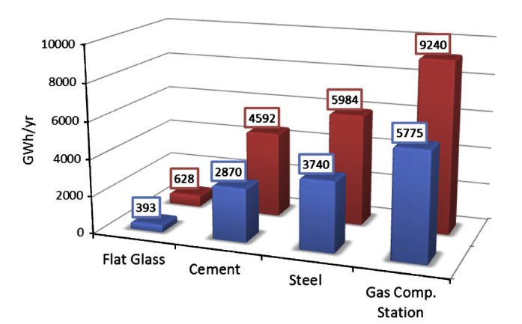
Potential
2705 MW of ORC gross power
21.6 TW h per year of electricity production
~2% of the European Industry consumption
Market size: 8-9 billion euro
Source: Campana et al., ORC waste heat recovery in European energy intensive industries: Energy and GHG savings
Notes:
Red: 8000hr/y
Blue 5000hr/y
Market size considering 3000€/kw

Slide 26
Conclusions
ORC market is growing exponentially since the early 80’s
The technology is applicable to much diversified fields (although solar is less developed)
Few applications in the KW power range
Optimal working fluid for each application and each temperature range
Positive-displacement are preferably used for small-scale applications while turbomachines are used for higher power ranges
In waste heat recovery, could cover 2% of the industrial electricity consumption
More research is needed to quantify the overall potential of the technology in different areas
Notes:
I will just skip the first points of the conclusion because it is only summarizing what I have just said. But I would like to highlight the last point, which is the necessecity to asses the potential of the ORC technology.

Slide 27
Thank you!

Slide 28
R&D Trends

Slide 29
Current R&D

Slide 30
R&D trends
Waste heat recovery (140 TWh_{th} /year in EU):
  At low t°, necessary to increase the performance of the system to allow for economical profitability
  Improve control (transient heat sources)
  Design heat exchangers able to work in corrosive environment (EU LOVE project)
  Transcritical operation
Small scale systems (<50 kWe):
  Niche markets
  Internal combustion engines
  µ-CHP
  small solar plant for off-grid power production
  adapted positive displacement machines
Still a lot of R&D work to be performed
Necessary to develop adapted modeling and simulation tools (necessary at ≠ levels of the design)

Slide 31
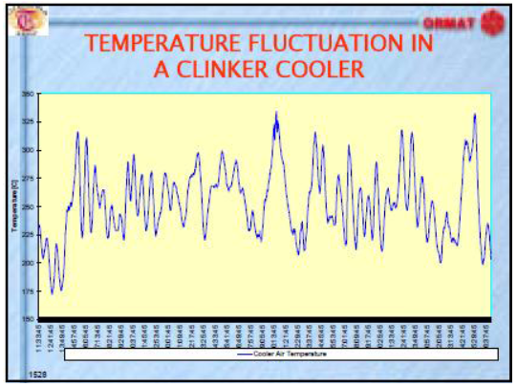
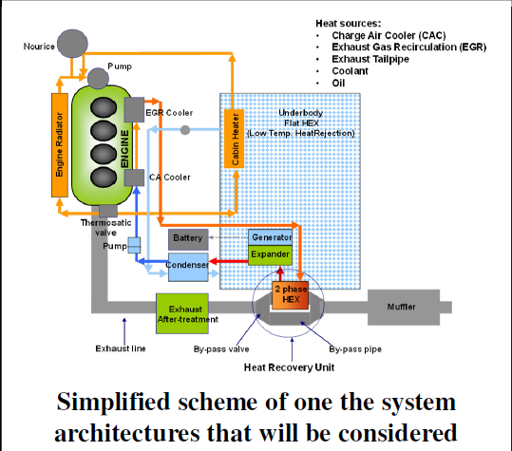
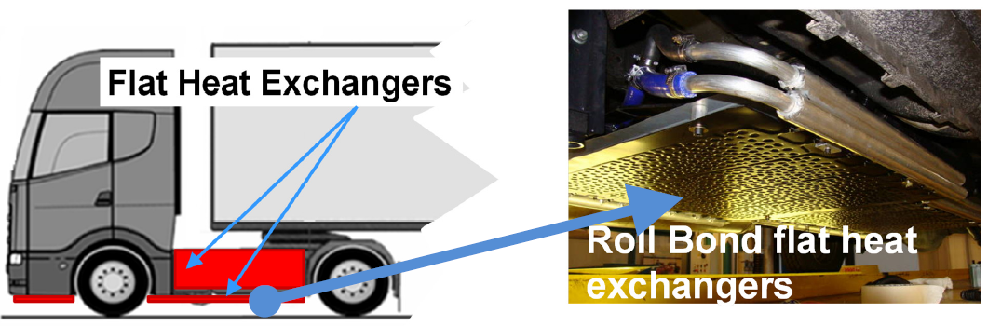
Current R&D
Transient analysis
Variable Waste Heat Sources
Start-up time and cost
Waste Heat recovery on Vehicles

Slide 32
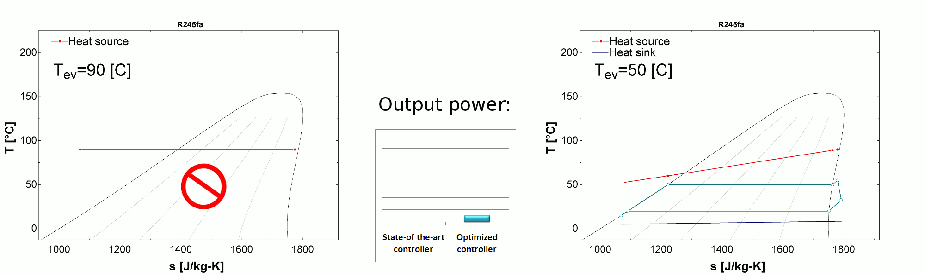
Transient regime analysis
Why controlling?
Main optimization parameter: the evaporating pressure (controlled by means of the expander speed)
Traditional ORC:
Best ORC

